Slide 1
Design documentation is a collection of documents that cover all of the most important aspects of product or service design.

Slide 2
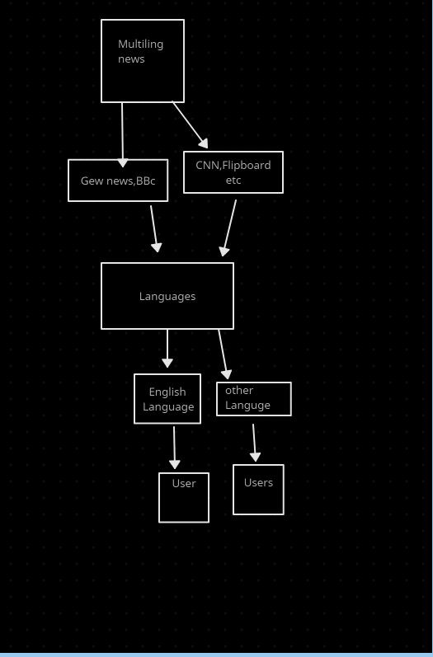
An Entity Relationship (ER) Diagram is a type of flowchart that illustrates how “entities” such as people, objects or concepts relate to each other within a system. ER Diagrams are most often used to design or debug relational databases in the fields of software engineering, business information systems, education and research. Also known as ERDs or ER Models.

Slide 3
Sequence Diagrams are interaction diagrams that detail how operations are carried out. They capture the interaction between objects in the context of a collaboration. Sequence Diagrams are time focus and they show the order of the interaction visually by using the vertical axis of the diagram to represent time what messages are sent and when.

Slide 4
An architectural diagram is a visual representation that maps out the physical implementation for components of a software system.

Slide 5
In software engineering, a class diagram in the Unified Modeling Language (UML) is a type of static structure diagram that describes the structure of a system by showing the system's classes, their attributes, operations (or methods), and the relationships among objects.

Slide 6
An architectural diagram is a visual representation that maps out the physical implementation for components of a software system.

Slide 7
Database design is a collection of steps that help create, implement, and maintain a business's data management systems.

Slide 8
Designing User Interfaces for Users
User interfaces are the access points where users interact with designs. They come in three formats:

